Slide 1

Store Façade PPT GUJRAT

Slide 2
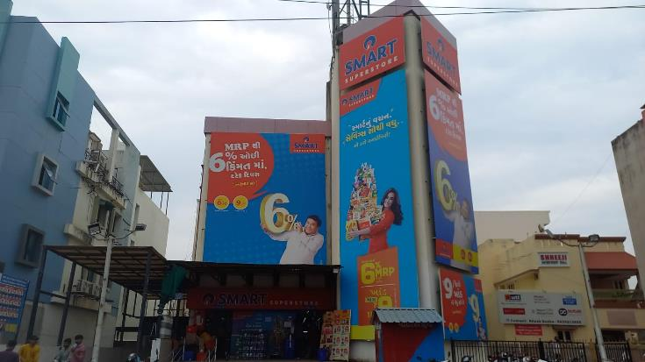
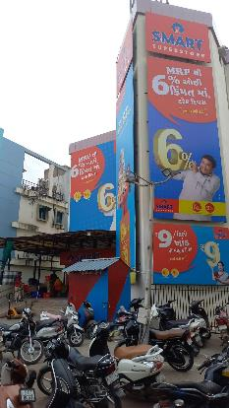
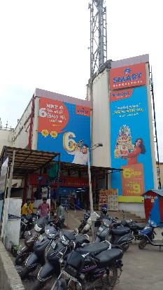
Smart Super Store Moti Bagh-JUNAGARH 3097

Slide 3
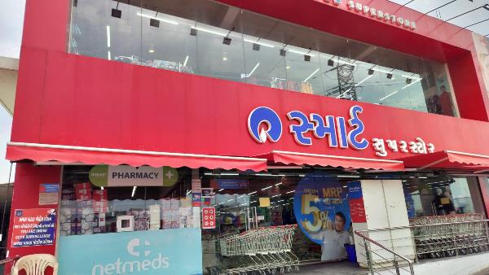
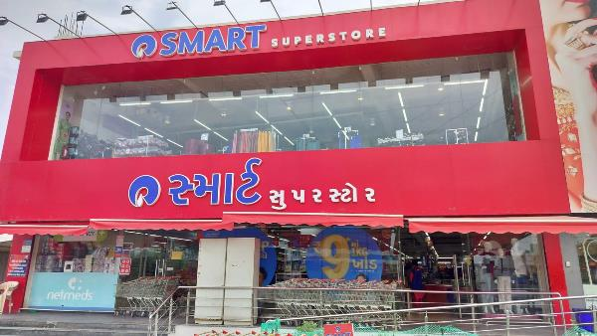
Smart Super Store-Veraval TZS2

Slide 4
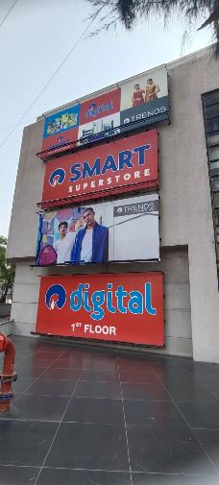
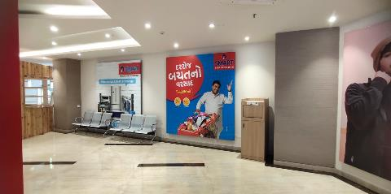
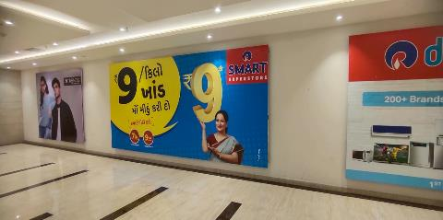
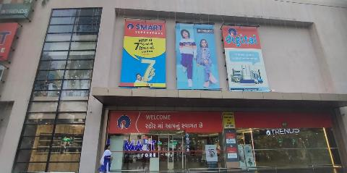
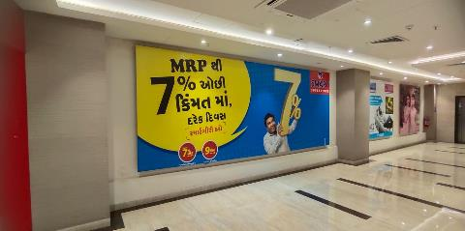
Smart Super Store-Surat Adajan-TU42

Slide 5
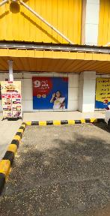
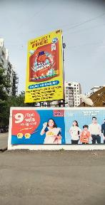
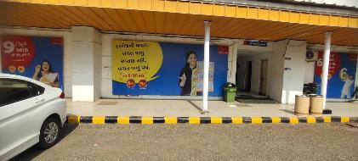
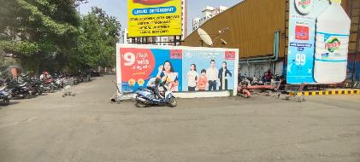
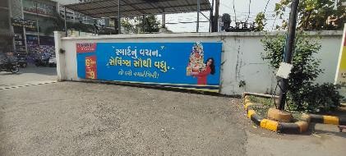
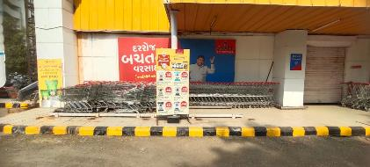
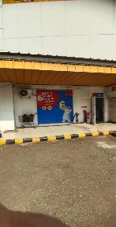
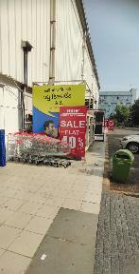
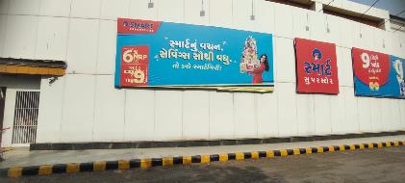
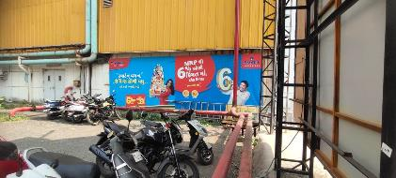
Smart Market -Surat Vesu TND5

Slide 6
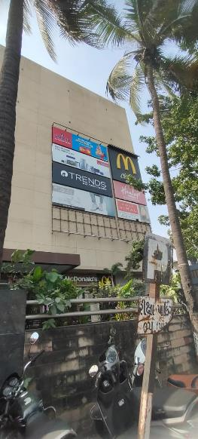
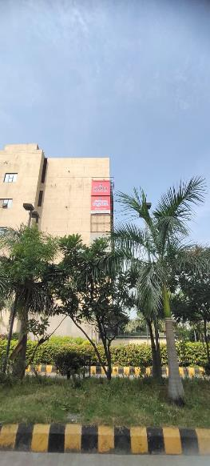
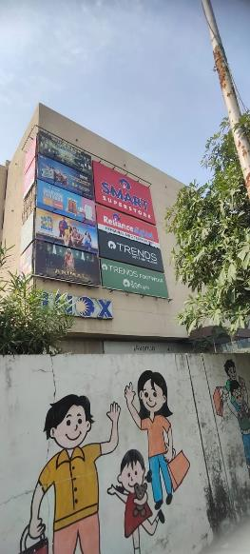
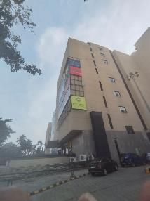

Smart Super Store -Surat Udhna 2964

Slide 7
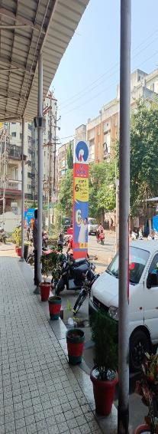
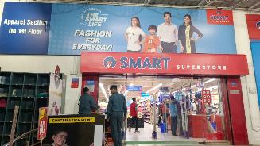
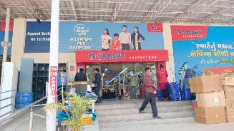
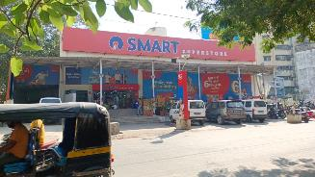
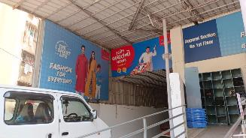
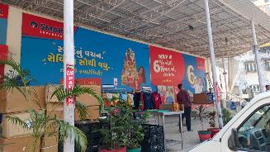
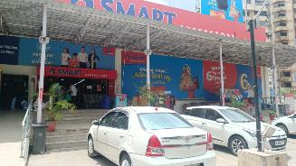
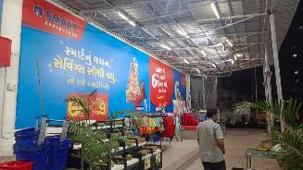
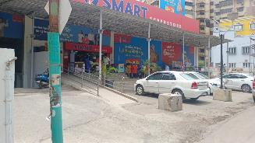
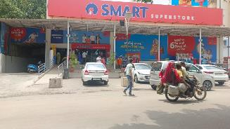
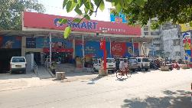
Smart Super Store -NAVSARI 6703

Slide 8
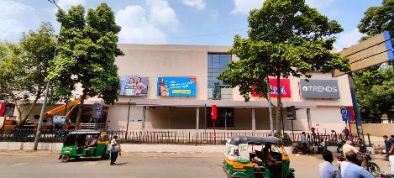
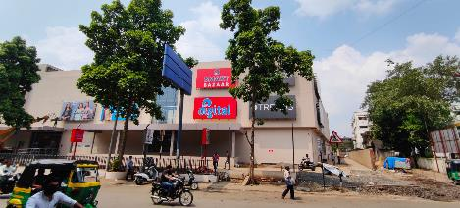
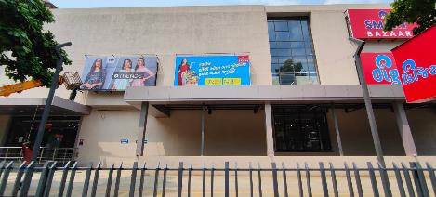
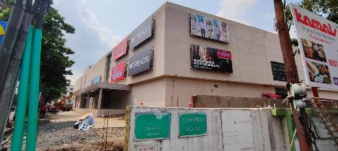
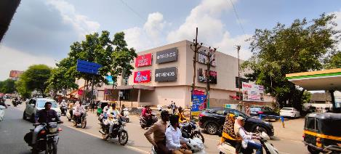
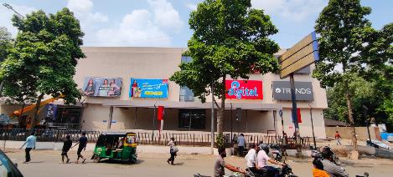
Smart Bazaar-Surat Varaccha TG7Q

Slide 9
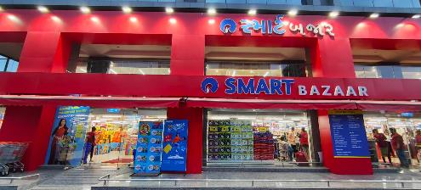
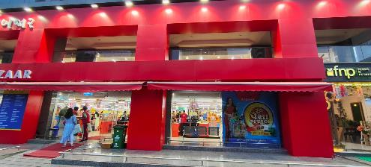
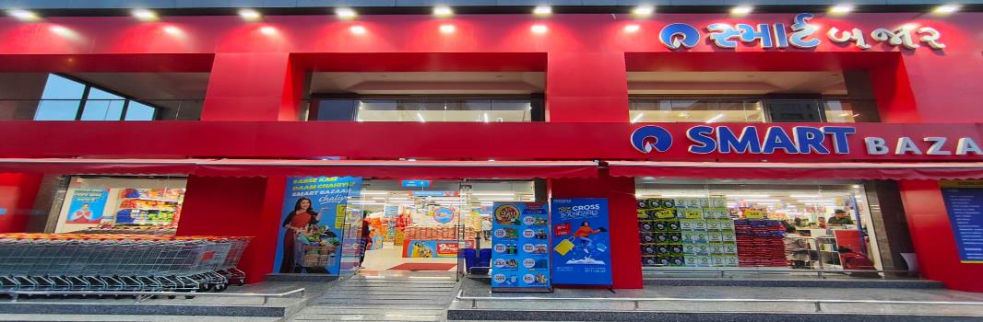
Smart Bazaar-Surat Roongta T84L

Slide 10
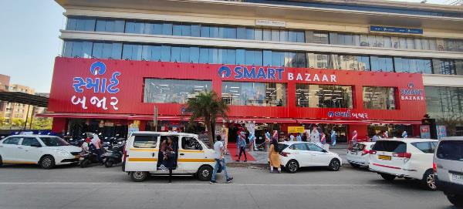
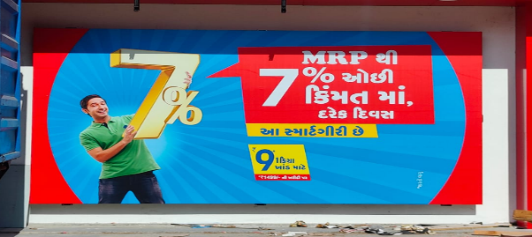
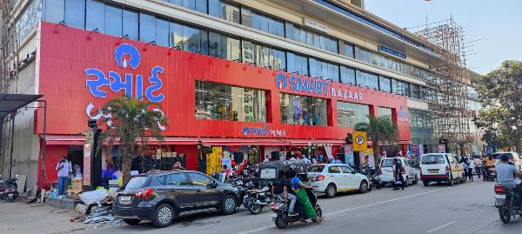
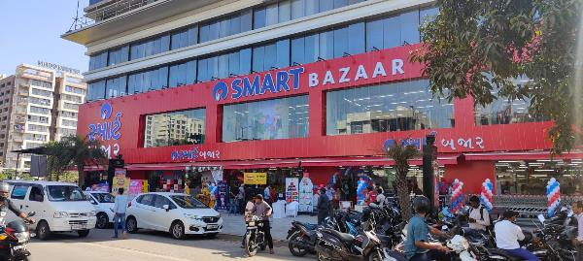
Smart Bazaar-Surat Rio Empire TAWP

Slide 11
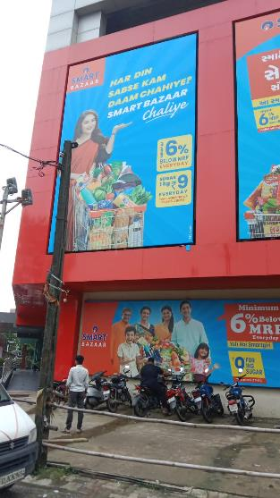
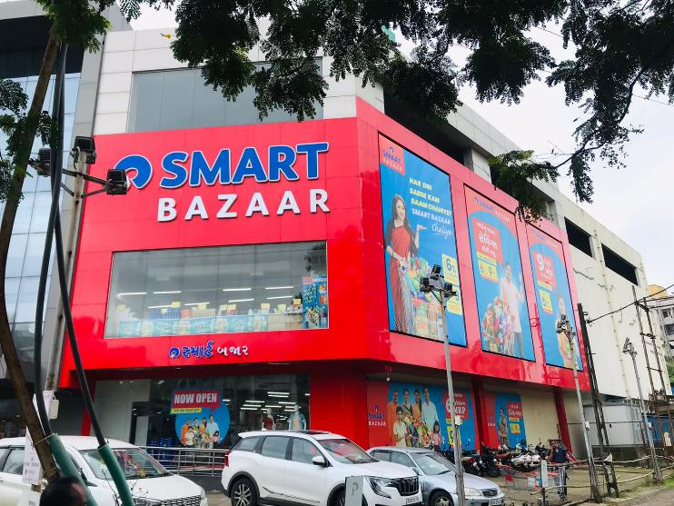
Smart Bazaar - VAPI FREL

Slide 12




Smart Super Store-Vadodara Omkara TP74

Slide 13



Smart Bazaar AHM Arne-T1DT

Slide 14

Smart Super Store-GANDHIDHAM

Slide 15




Smart Bazaar-AHM Abc SLMP

Slide 16





Smart Super Store-AHM Celebration Mall Bopal TKE5

Slide 17


Smart Super Store-Botad TKD3

Slide 18


Smart Bazaar-AHM Isanpur TA9O

Slide 19



Smart Market-AHM Advance Mills TNA8

Slide 20


Smart Super Store-JAMNAGAR MK 6203

Slide 21












Smart Super Store- AHM ISKCON 6202

Slide 22

Smart Bazaar -AHM Venus TA8F

Slide 23


Smart Bazaar -AHM Vastral TA9P

Slide 24


Smart Super Store-Gandhinagar TMS4

Slide 25


Smart Bazaar-Mandvi T85U

Slide 26



Smart Bazaar-Porbandar T1E1

Slide 27




Smart Bazaar-AHM science City TAUX

Slide 28


Smart Super Store- BHUJ 3205

Slide 29

Smart Super Store-Ahm Drive in 6237

Slide 30



Smart Bazaar-JUNAGARH TZ7I

Slide 31






Smart Bazaar-Bharuch FRDV

Slide 32




Smart Super Store-Bharuch 3206

Slide 33





Smart Super Store-Vapi 3202

Slide 34


Smart Super Store-Himatnagar 3203

Slide 35

Smart Super Store-Nadiad 3214

Slide 36


Smart Market-BHAVNAGAR-TNB5

Slide 37

Smart Super Store-BHAVNAGAR-3208

Slide 38



Smart Market-Rajkot TND1

Slide 39


Smart Super Store-AHM HighStreet 3207

Slide 40

Smart Super Store-JAMNAGAR 6704

Slide 41



Smart Super Store-AHM Naroda TIY4

Slide 42

Smart Bazaar-Naoroji Estate Bhuj TG2K

Slide 43




Smart Bazaar-AHM Nikol TZ7K

Slide 44



Smart Bazaar-GANDIDHAM FRGN

Slide 45

Smart Super Store-Morbi TKE5

Slide 46


Smart Super Store-GANDHIDHAM 3204

Slide 47



Smart Bazaar-AHM Odhav T19P

Slide 48



Smart Bazaar-BHAVNAGAR FRDW

Slide 49



Smart Bazaar-Rajkot FRDX

Slide 50


Smart Bazaar-Anand FRDU

Slide 51

Smart Super Store-MehsanaTGO8

Slide 52



Smart Bazaar-Vadodar 7seas FREB

Slide 53


Smart Super Store-AHM Yash Arrian TQ10

Slide 54


Smart Super Store-Anand 3201

Slide 55

Smart Bazaar-Surendranagar T23E

Slide 56



Smart Bazaar-Amreli TZYI

Slide 57




Smart Bazaar-Vavol TH3N

Slide 58

Smart Super Store-Vadodara Mangalya 6712

Slide 59









Smart Bazaar-Surat FRDY

Slide 60




Smart Bazaar-Surat FRDY

Slide 61




Smart Bazaar-Surat FRDY

Slide 62




Smart Bazaar-Surat FRDY

Slide 63




Smart Bazaar-Surat FRDY

